Slide 1



Lecture-1
Introduction to Web
Introduction to Full Stack
Kartik Mathur

Slide 2



Syllabus
FRONT END
HTML/CSS
JS – Mostly asked in interviews
jQuery
Bootstrap
ReactJS
Next JS
Tailwind - CSS
TypeScript
AXIOS/FETCH

Slide 3
Syllabus
Backend
Node JS
MongoDB and Mongoose
Postgres SQL and Prisma
GraphQL: API Query language
WebSocket
Authentication: JWT/Google etc.
Projects
Spotify Clone
Todo List – Multiple ways
URL Shortener
Chat APP
Text – Editor using Draft.js
Blog Management System
Medium Clone/E-commerce Clone or any similar project.
CAPSTONE PROJECT: Students can decide.

Slide 4
Syllabus
Deployment
AWS
Testing
Chai/Mocha
Hackathons – Minimum:3
To build projects during the limited time frame.

Slide 5
Software
Visual Studio Code Download
GOOGLE “DOWNLOAD VISUAL STUDIO CODE”

Slide 6
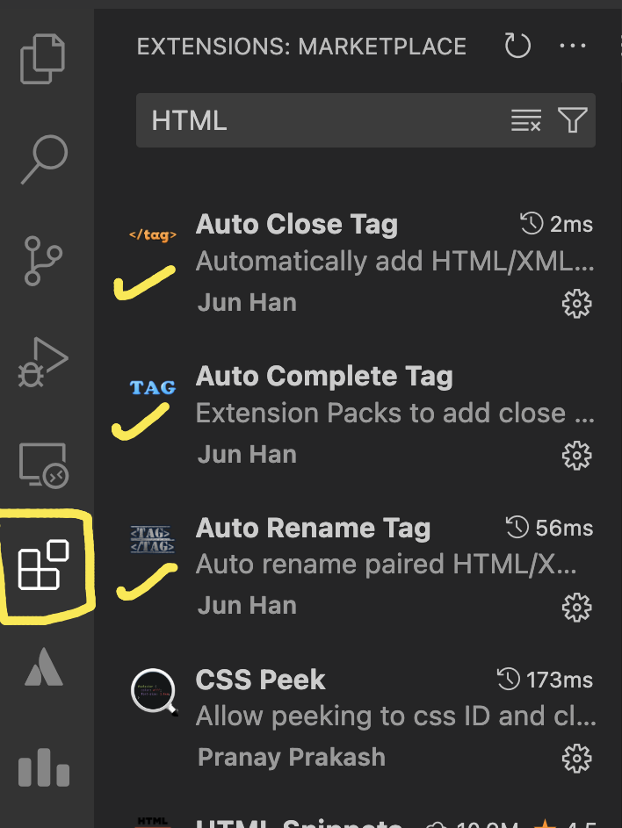
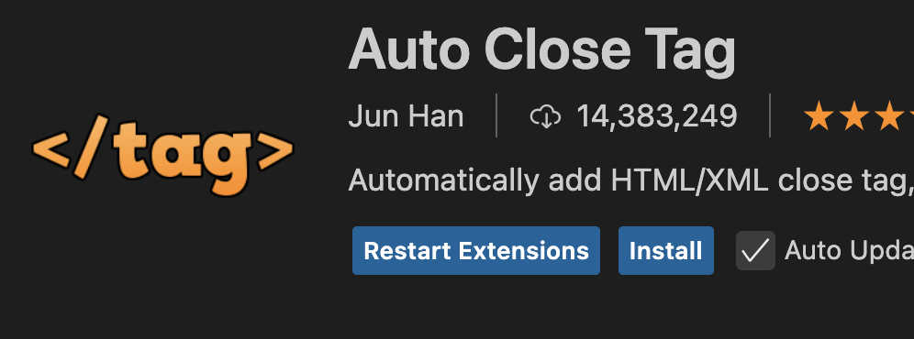
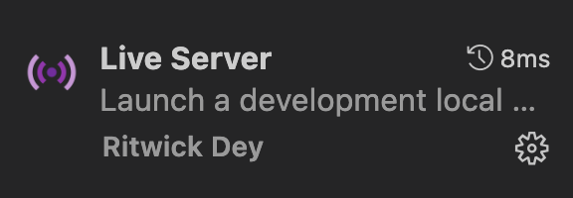

Type these names in search box at top
Extensions
Click on Install to download extension

Slide 7
LET’S GET STARTED!

Slide 8
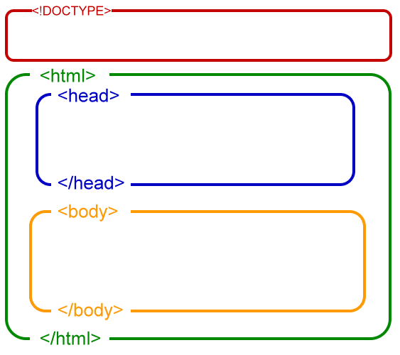
HTML TAGS
We need HTML Tags to create the structure of our website.

Slide 9
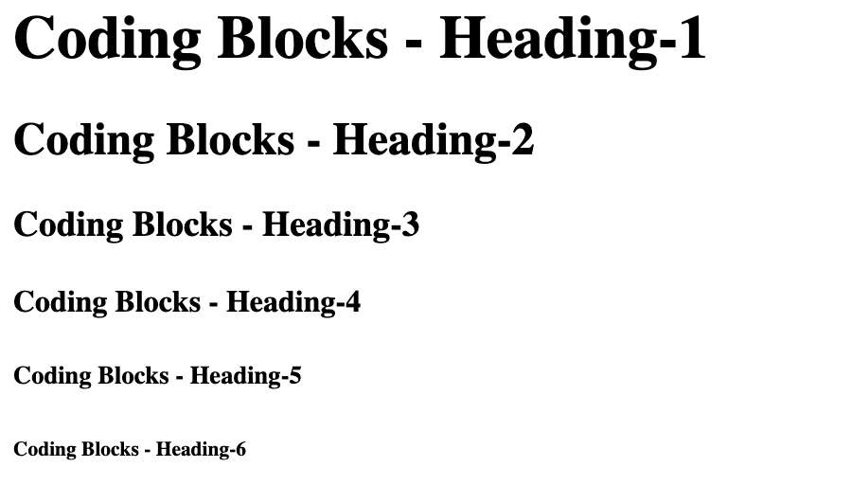
HTML Heading Tags

Slide 10
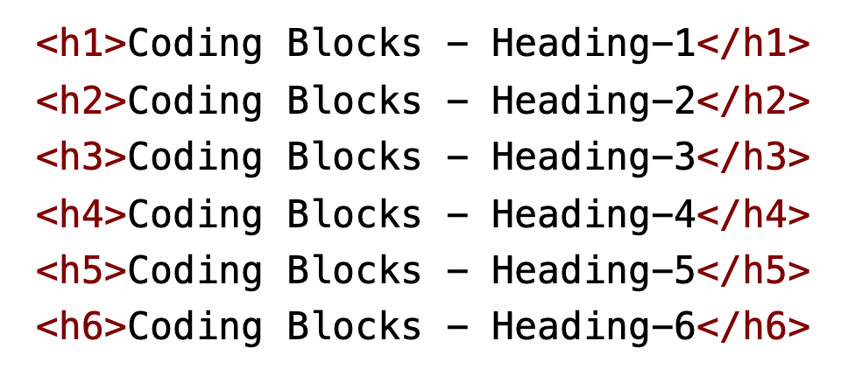
HTML Heading Tags

Slide 11
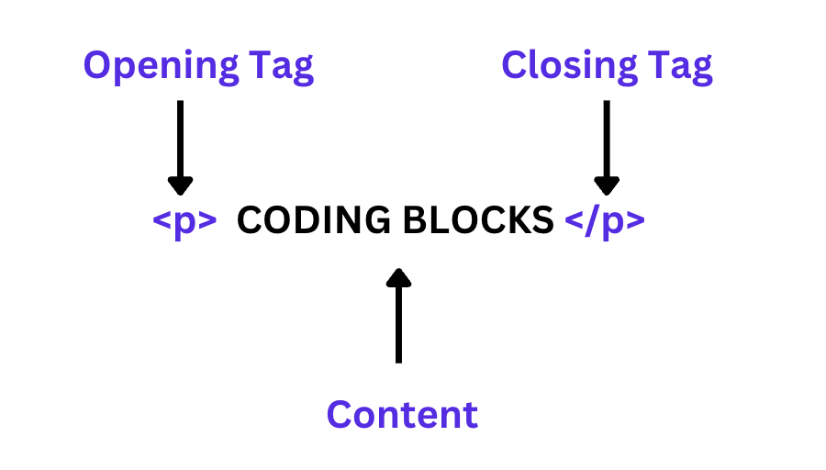
Paragraph Tag

Slide 12
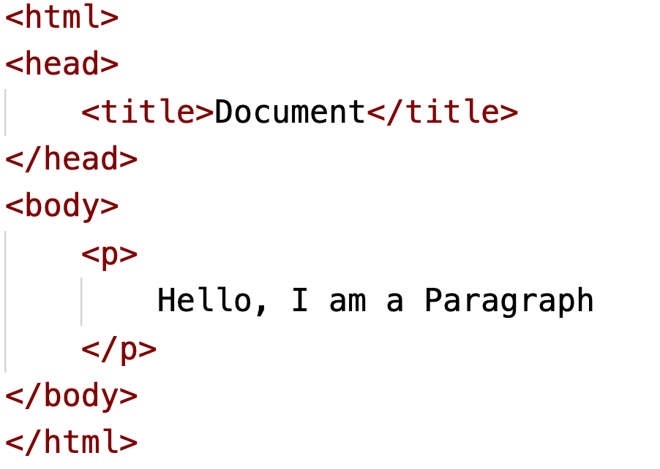
Paragraph Tag

Slide 13
What is View Port?

Slide 14
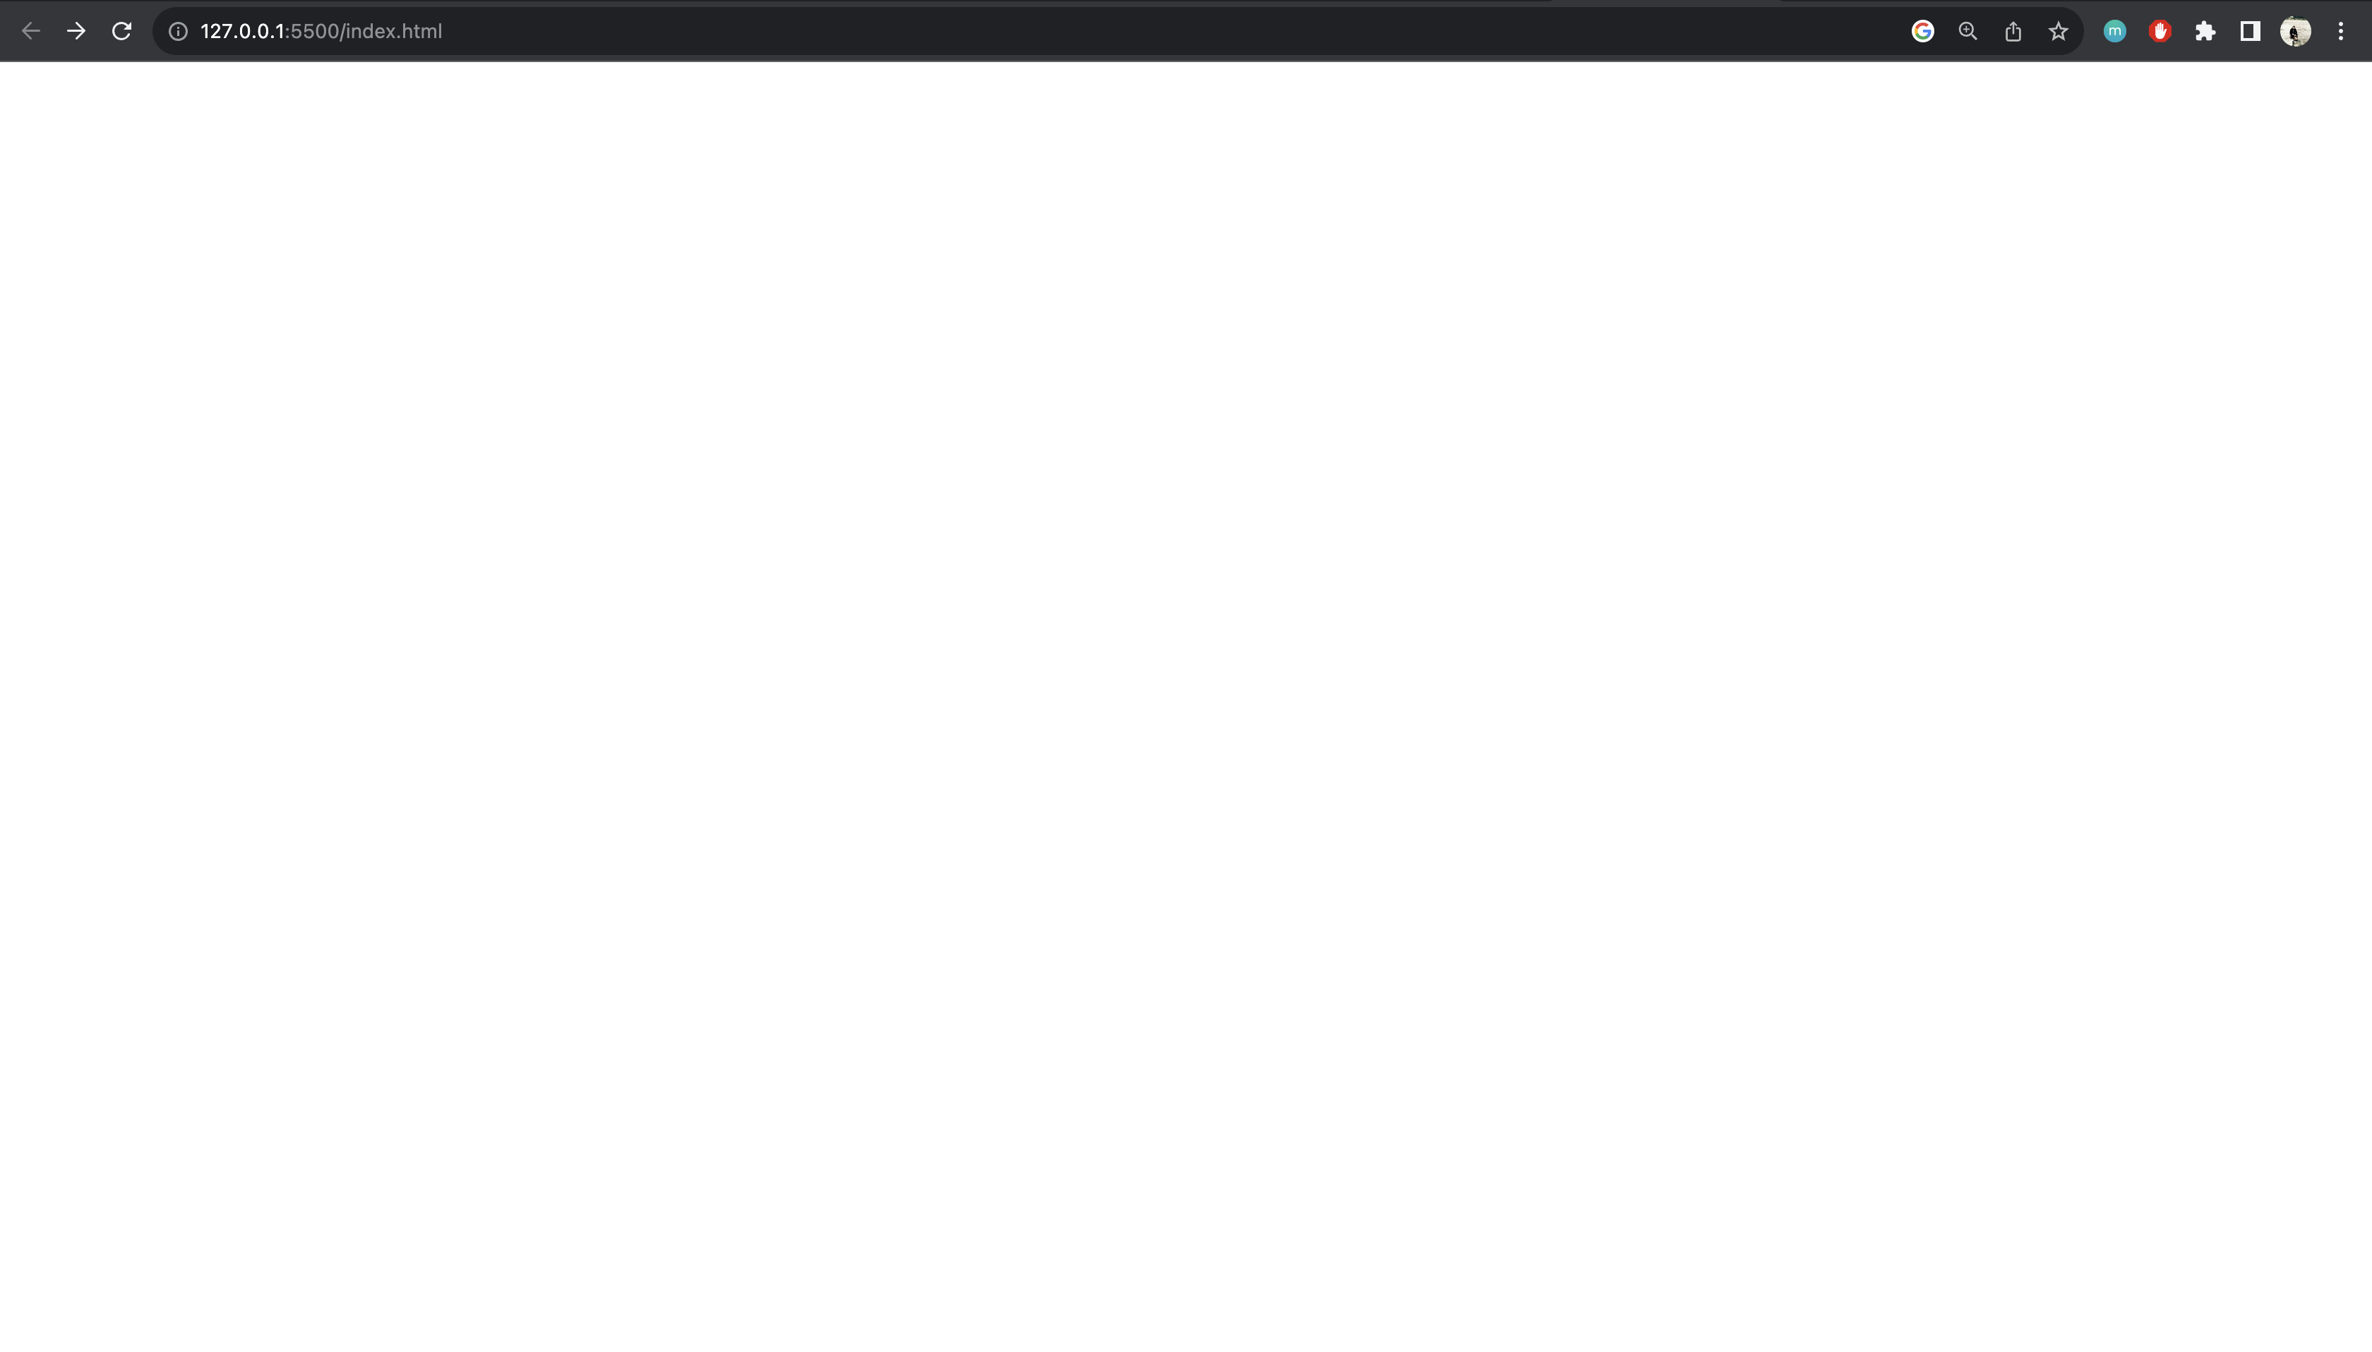
View Port

Slide 15
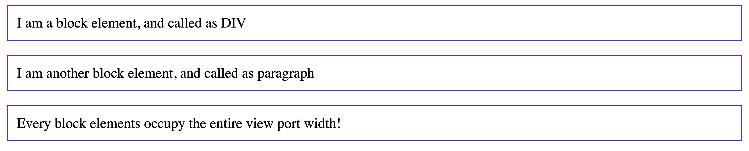
Inline v/s Block Elements

Slide 16
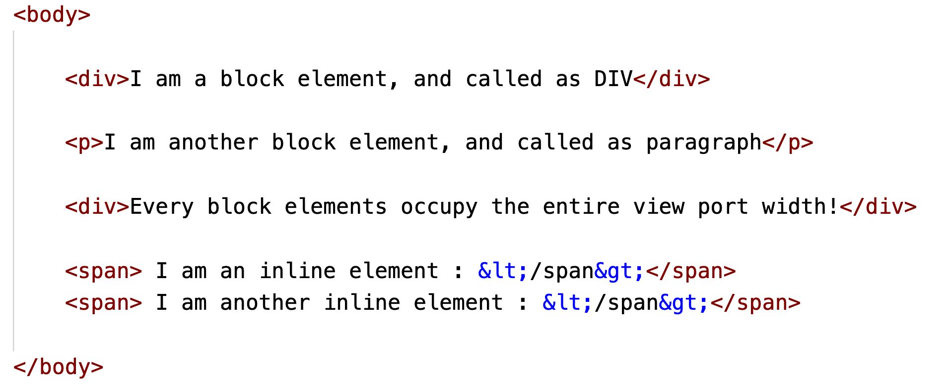
Inline v/s Block Elements

Slide 17
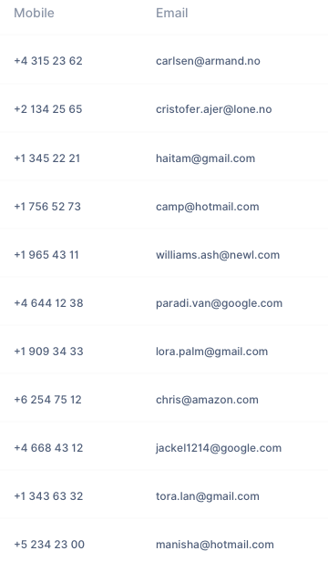
What are Lists?
List of mobile numbers or list of emails!

Slide 18
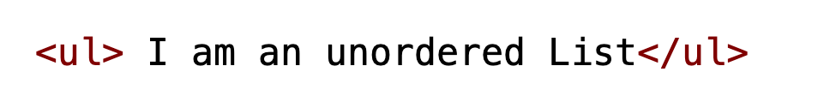
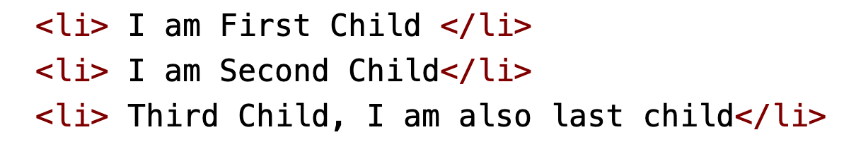
Unordered List!
Children

Slide 19

Ordered List!
Children

Slide 20
Attributes?
Key/s that we can write inside our tags.
Every element have their own attributes
Some tags may or may not have the same attributes.

Slide 21
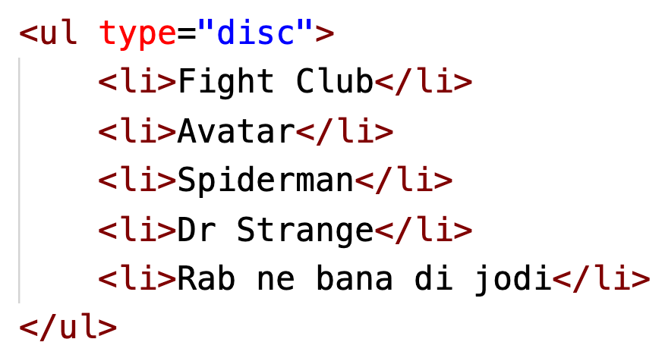
Attributes for <ul>?
We can have type attribute for ul.
type can be
disc (Default)
circle
square

Slide 22
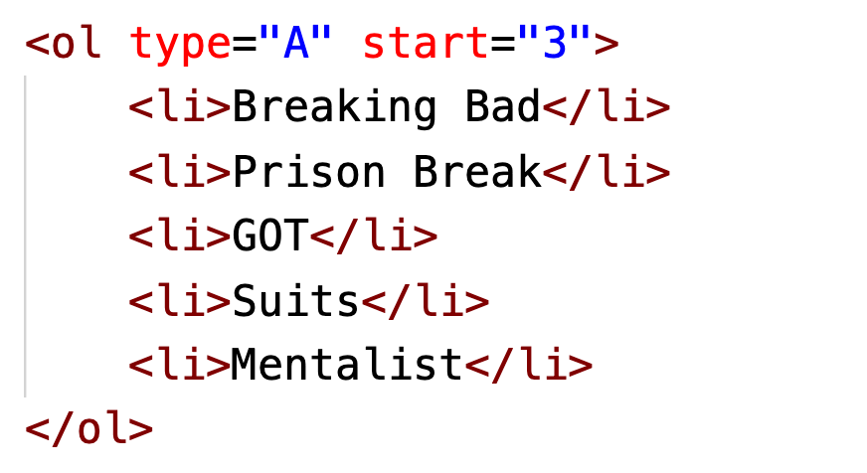
Attributes for <ol>?
We can have type and start attribute for ul.
type can be
1: Number (Default)
A/a: Alphabet
I/i: Roman
start is always an integer only.

Slide 23
LEARN TO GOOGLE!

Slide 24
TELL ME ABOUT TABLE TAG?

Slide 25
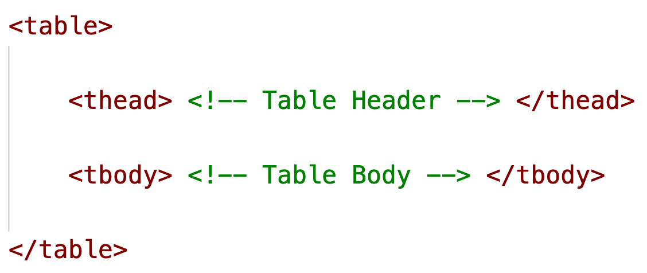
<table> Tag?

Slide 26
<table> Tag?
<thead> and <tbody> Tags can have three children:
<tr>: Row
<th>: Heading
<td>: Data

Slide 27
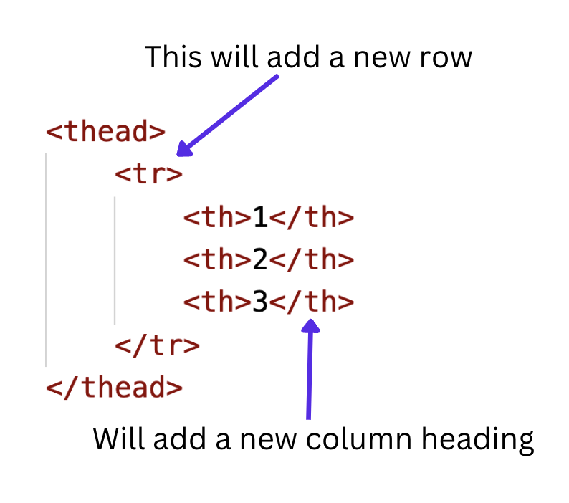
<table> Tag?

Slide 28
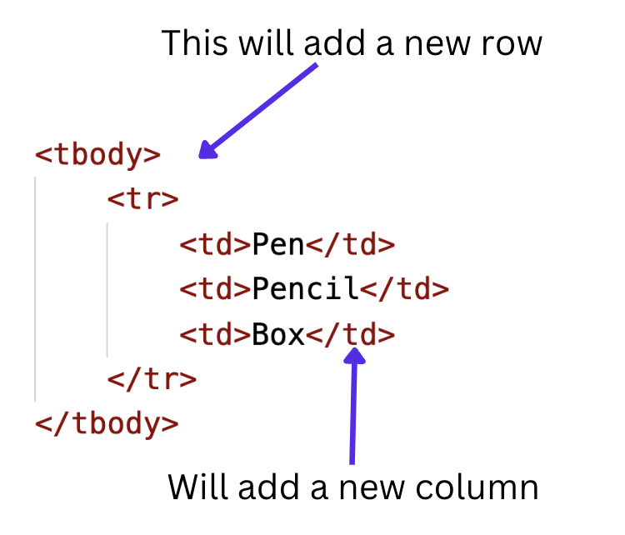
<table> Tag?

Slide 29
GOOGLE ME!
TABLE ATTRIBUTES?

Slide 30
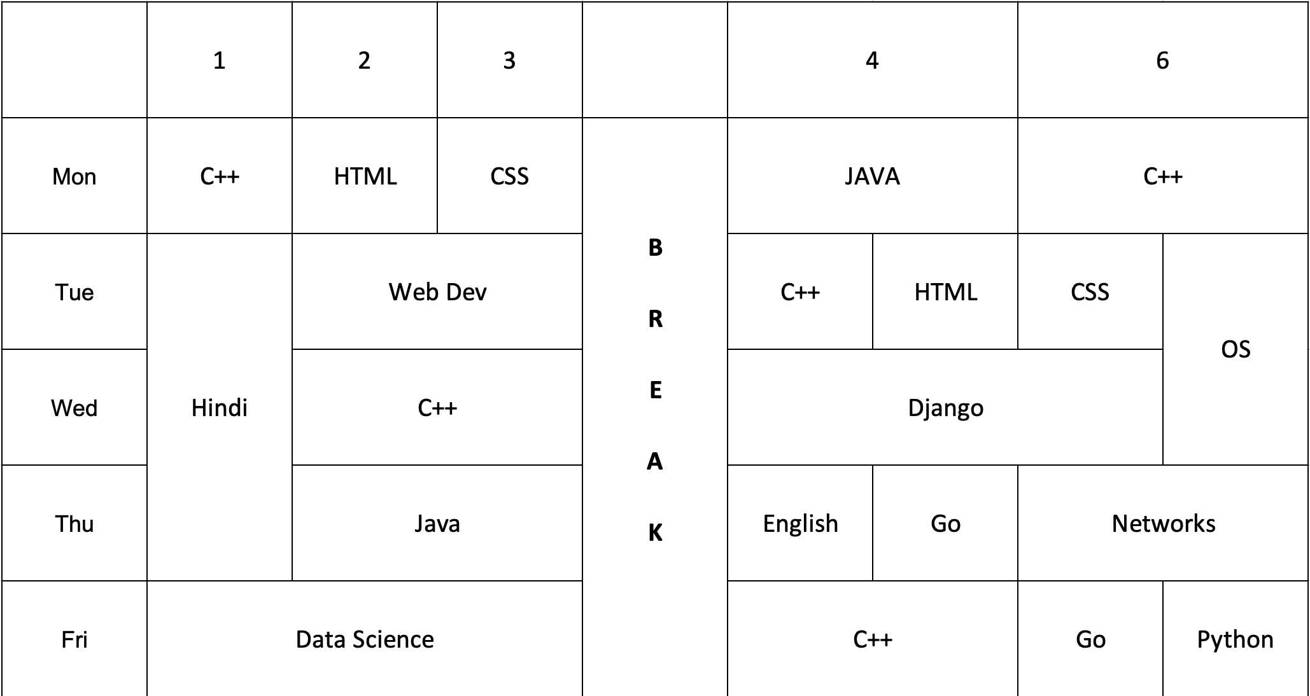
Mini Project!

Slide 31
DON’T Take WEB-DEV like DSA!
You don’t need to know everything
But you need to know how to google it!

Slide 32
Thankyou!
Kartik Mathur

